Slide 1
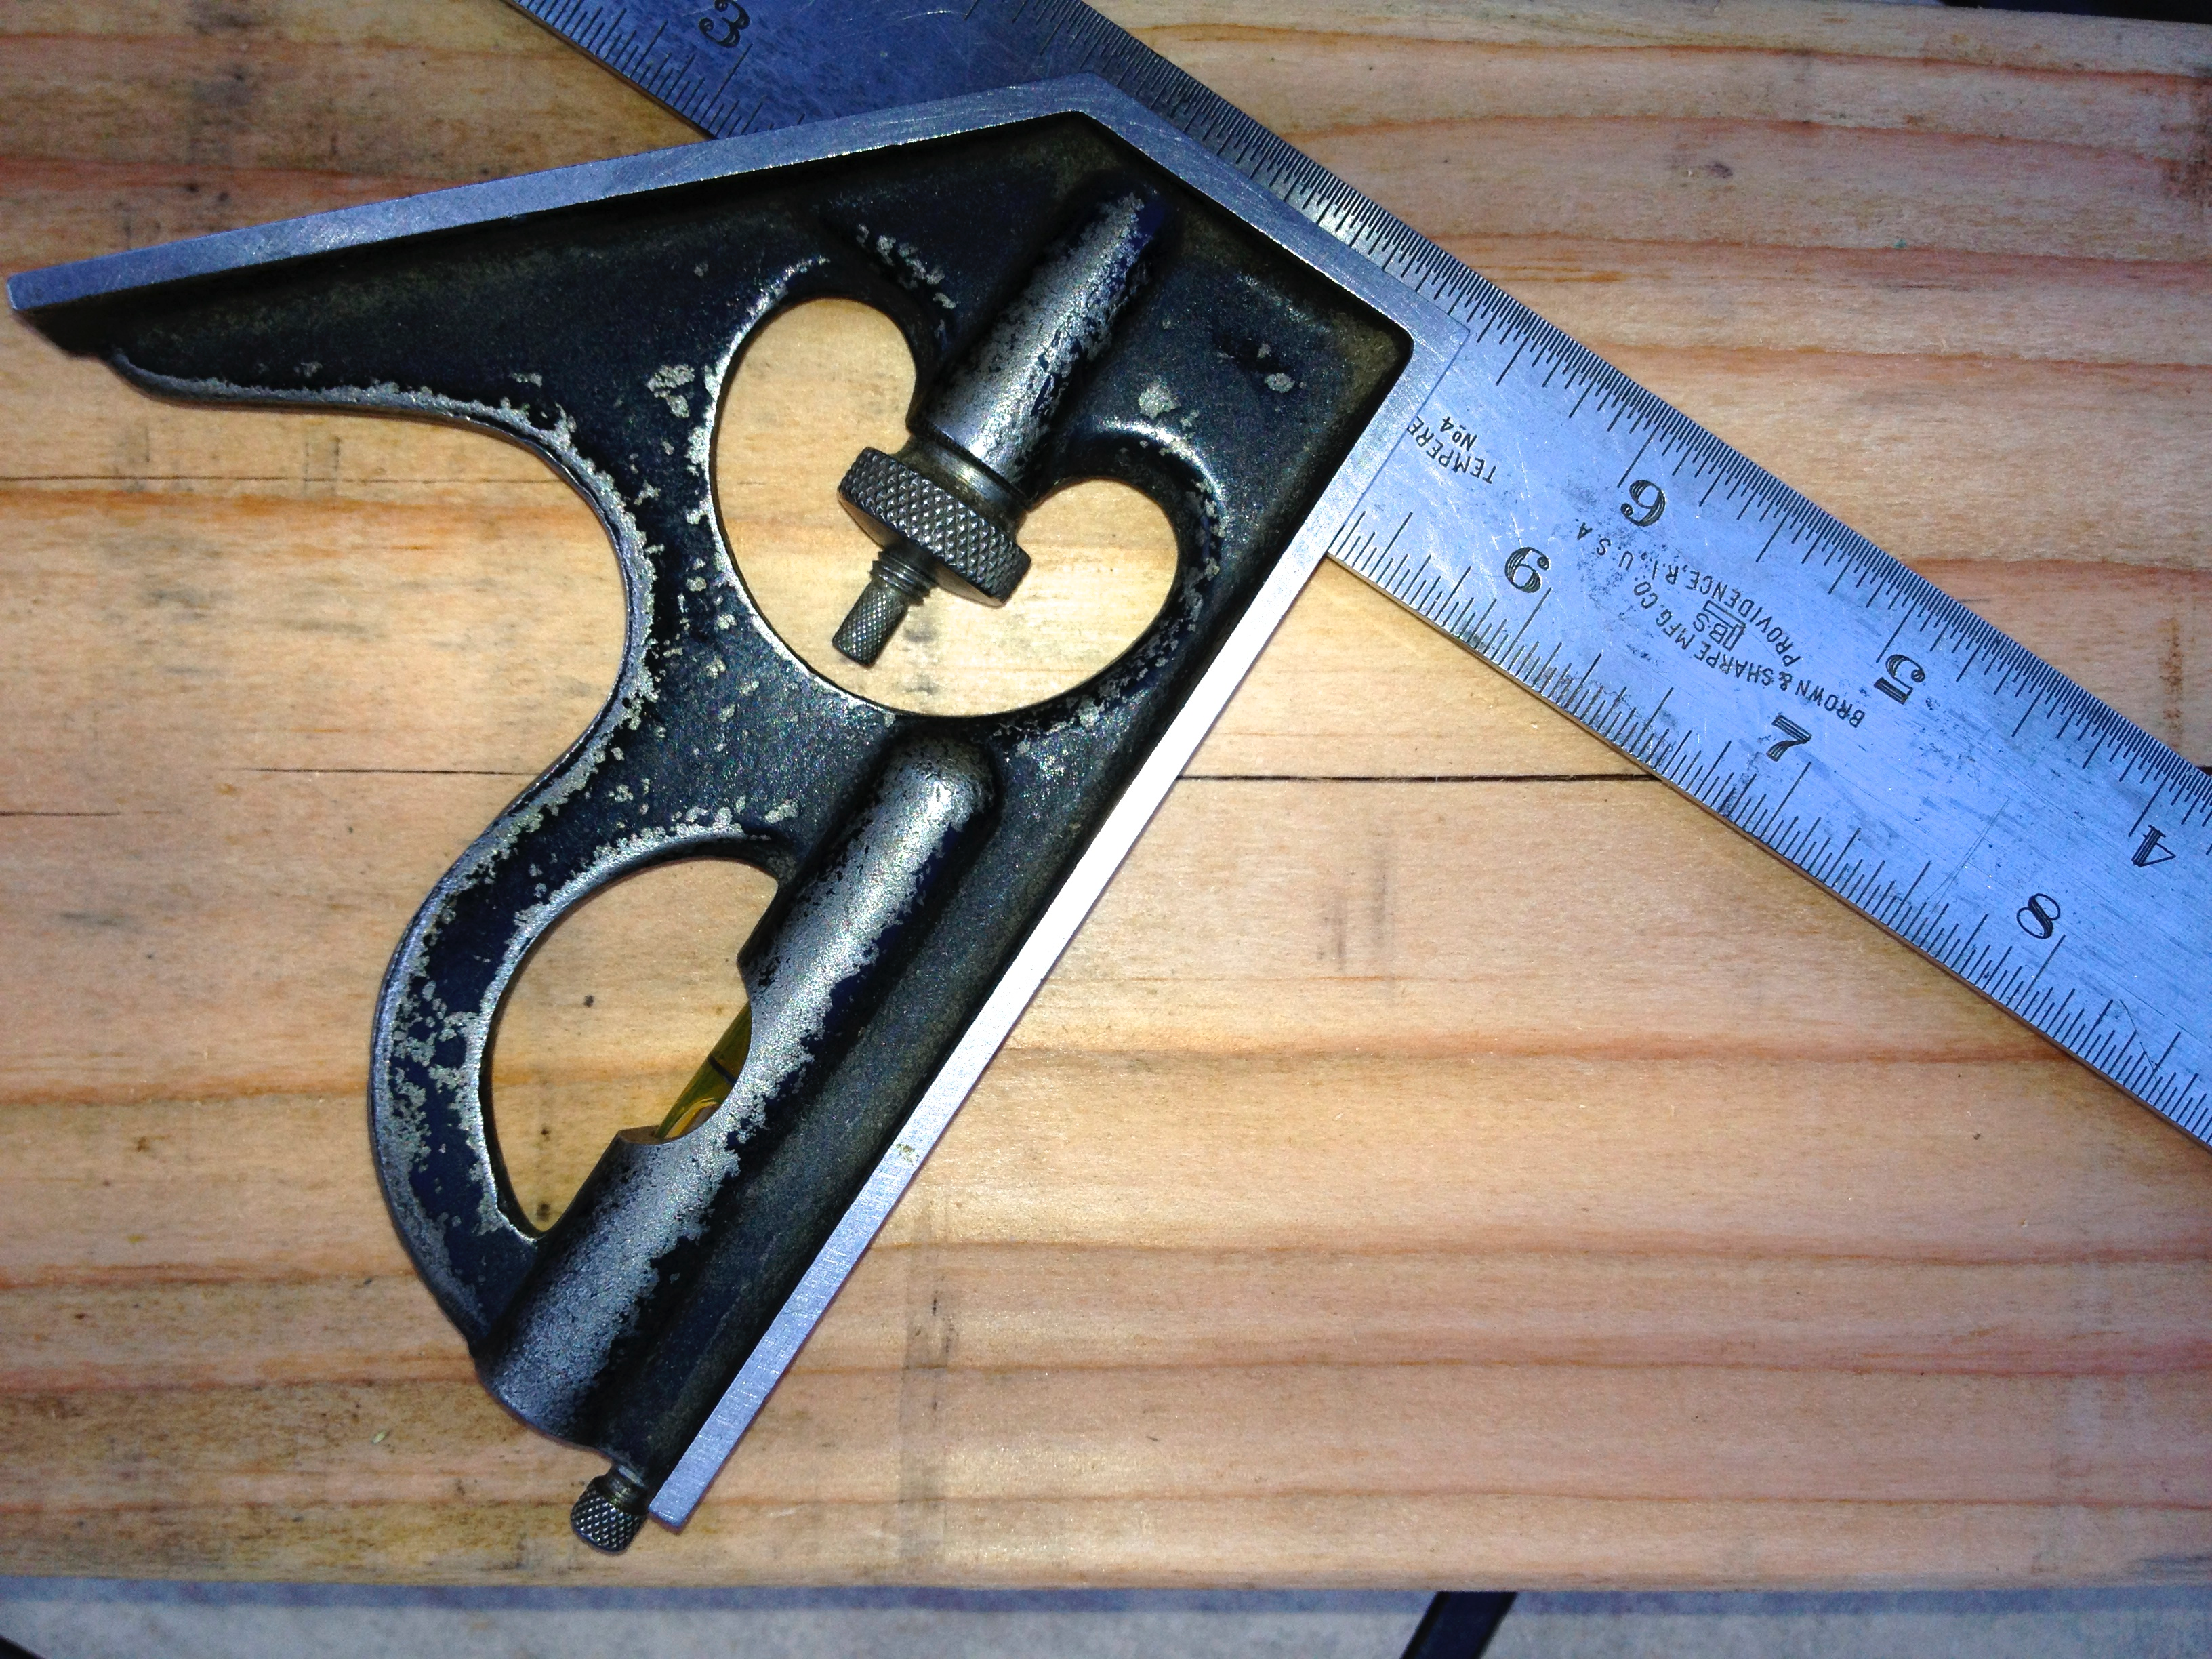
CS471 Lecture 12
Tools
Dr. Jim Conrad

Slide 2
Commercial Software:
Characteristics
Commercial software is large, sometimes really large
Commercial software often contains legacy code
The original authors are often no longer available
Developers enhance code they never created
Often developed, enhanced and repaired by multiple teams
Maybe remotely-located teams

Slide 3
Large-Scale Development
Multiple teams
Source code management system
Legacy code
My private builds (e.g. Eclipse) not shared with other developers
The project’s Build Server builds and tests the official bits

Slide 4
Commercial Software Tooling Needs:
Really Effective Test Coverage
Coverage
Unit-level Tests with strong coverage of the product classes
Integration Tests verify all our classes work together
The tests reveal more than does-my-code-work-as-I-expect
Tests notify me when my changes break the legacy code
Tests notify us when my changes don’t work with your changes
Much more than “does my new test work with my new code?”

Slide 5
Commercial Software Tooling Needs: Large Scale Integration
Need to know what breaks as soon as possible
The longer a defect lives, the more expensive it is to remove
Other changes begin to depend upon the defective code
Solution: Continuous build systems

Slide 6
Software Tools:
Categories
Project Management
Analysis and Design
Version Control
Programming
Static Analysis
Unit-Level Testing
Defect Tracking
Build Automation

Slide 7
Software Tools:
Project Management
XPlanner: SCRUM Project Management
Microsoft Project: Waterfall Project Management using GANTT

Slide 8
Software Tools:
Analysis and Design
XPlanner: Stories
ArgoUML: UML
Enterprise Architect: UML (Very complete)
Object Aid: UML Class and Sequence Diagrams
CRC Cards: Test a design

Slide 9
Software Tools:
Version Control
Concurrent Versions System (CVS): Very old, client-server.
Subversion (SVN): Popular client-server.
GIT: Distributed

Slide 10
Software Tools:
Programming: IDEs
Eclipse: Java, C/C++, PHP, Ruby, etc
Visual Studio: C#, C/C++, Visual Basic, etc

Slide 11
Software Tools:
Pair Programming: Saros
Eclipse plug-in: http://www.saros-project.org
Ideal for remote agile development
All collaborators have an identical copy of Eclipse projects
2..5 collaborators may concurrently edit same file

Slide 12
Software Tools:
Static Analysis
Fortify: Security focus. Multiple languages.
StyleCopy: C#
FindBugs: Java
Coverity: Multiple languages. Extensive.

Slide 13
Software Tools:
Unit-Level Test Frameworks
JUnit: Java
cppunit: C++
NUnit: C#
PHPUnit: PHP
RUNIT: Ruby
JSUnit: JavaScript

Slide 14
Software Tools:
Test Coverage
EclEmma: Java coverage for Eclipse
Visual Studio: C# coverage
gcov-eclipse: C/C++ coverage for Eclipse
JSCover: JavaScript for IE6, 7, and 8, Firefox, Opera, Safari, and Google Chrome

Slide 15
Software Tools:
Defect Tracking
Bugzilla
JIRA

Slide 16
Software Tools:
Build Automation
Ant: Java…
Maven: Java…
Make
CruiseControl: Classic Continuous Integration (Runs the build in a loop on a build server)
Hudson: Emerging Continuous Integration server (Ease of use, distributed builds, extensive SCM, etc)

Slide 17
Build Automation:
Why?
Many small projects need little more than a compiler to build
Large commercial software products have more complex builds
Must avoid Big-Bang Integration

Slide 18
Build Automation:
Integration
Large software products include multiple components
Examples: UI, business logic, database, device driver
Multiple languages
3rd Party (binary-only) libraries
Hundreds of thousands of lines of source code
Developed by different teams
Potentially remotely located
Developed in-house or acquired
Both legacy and newly written
Each component potentially on its own versioning schedule

Slide 19
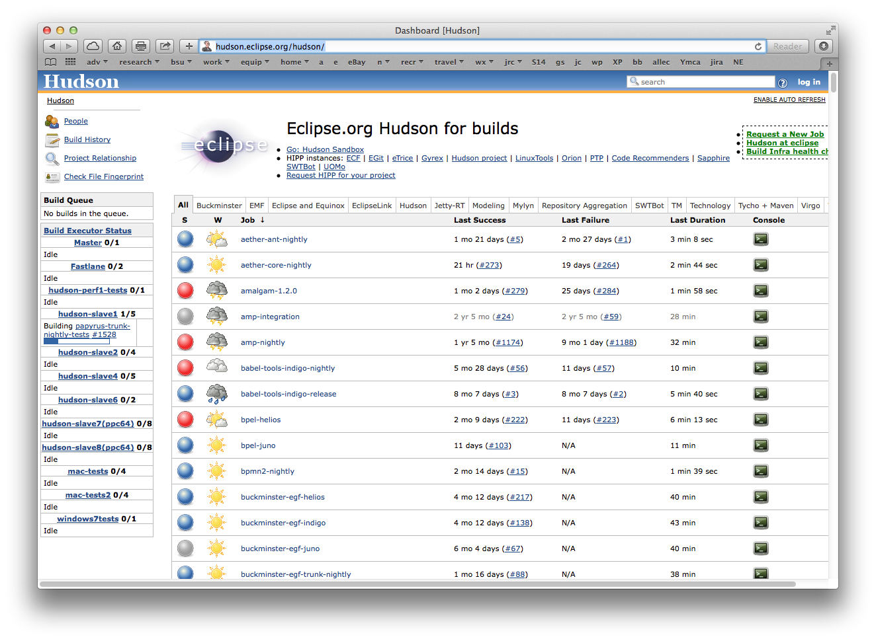
Hudson Continuous Build Server
http://hudson.eclipse.org/hudson

Slide 20
Some Testing Terminology
Unit-level tests: Exercise a class
Integration tests: Exercise a set of classes working together
Regression testing: Execution of previously passing tests

Slide 21
Build Automation:
Modern Product Integration
Configuration Control (the “right” versions of the compiler[s], source code, libraries, etc)
Build frequently… at least daily… preferably continuously
Check-out the latest source code
Compile the components
Run the unit-level tests (Does each class work by itself?)
Run the integration tests
Build components (class, library, driver, servlet, database, etc)
Static analysis, test coverage, javadoc…

Slide 22
Continuous Integration
The opposite of Big-Bang Integration
Comparable to Synchronize and Stabilize’s daily synchronization, but more intense
Continuously builds and tests the latest committed changes
Repeatable
Integration Defects, like cancer, have a better prognosis when found-and-fixed as soon as possible (before they spread)

Slide 23
Build Automation
Regression Testing
Exercises product with previously passed tests
Has a defect been introduced by a change?
Product enhancement or defect repair
Configuration change (compiler, web server, library, dbms, OS, …)

Slide 24
Introducing Maven
Build automation, primarily for Java projects
Build once — not a continuous build loop (like Hudson)
Standardized project directory layout
Functionality mostly implemented in Maven Plugins
Comparable to but becoming more popular than ant

Slide 25
Maven Functionality:
Largely Delivered by Plugins
Compiling
Testing
Source code (version) management
Running a web server
Etc

Slide 26
Maven:
The Build Lifecycles
Don’t confuse with a software lifecycle
There are three built-in Maven lifecycles:
default: Builds your product for deployment
clean: Remove files generated by previous builds
site: Builds your documentation
Each lifecycle has several phases
http://maven.apache.org/guides/introduction/introduction-to-the-lifecycle.html

Slide 27
Maven:
Default Lifecycle Phases
Sequential phases for building the product. Includes:
process-resources: Check-out product source code from repository and run any required pre-processing
compile: Compile the product code
process-test-resources: Check-out test source code and files
test-compile: Compile tests
test: Run unit-level tests (without packaging/deploying product)
package: Build installation package (e.g. JAR, WAR…)
integration-test: Run integration tests
install: Install package in local repository
deploy: Copy to remote repository for sharing with other teams
Building test will build all phases before and including test
http://maven.apache.org/guides/introduction/introduction-to-the-lifecycle.html

Slide 28
Maven: Another Look
Lifecycles
default | clean | site
Phase: process-resources
Phase: compile
Phase: process-test-resources
Phase: test-compile
Phase: test
Phase: package
Phase: integration-test
Phase: install
Phase: deploy
Plugin:Goal Examples
scm:checkout
compiler:compile
compiler:testCompile
surefire:test
javadoc:javadoc
javadoc:jar
deploy:deploy

Slide 29
Maven:
Packaging
Define’s your project’s target packaging (e.g. pom, jar, war…)
Definition appears in your POM.xml file
E.g. <packaging>war</packaging>
The default is jar (The build will construct a jar file)
The packaging defines a default list of goals for each lifecycle phase

Slide 30
Maven:
Plugin Goals
A phase is responsible for a step/stage in a lifecycle
Packaging binds goals to phases
These goals determine what a phase actually does
Each phase may have (“bind”) multiple goals
A phase having no bound goals won’t execute in the build
A goal may be bound to more than one phase
Goals are defined in plugins

Slide 31
Maven:
Standard Project Folder Layout
Different than the standard Eclipse project folder layout
src
main: The product under development
java
resources: Copied to target (product files, databases, etc)
test: Tests exercising this product
java
resources: Copied to target (test files, databases, etc)
target: Output of the build
pom.xml
README.txt
NOTICE.txt
LICENSE.txt

Slide 32
Maven: Dependencies
Really large products consist of multiple Maven projects
Dependencies between these are common
Maven ensures dependent projects build/test successfully
A project’s POM.xml file has a <dependencies> section

Slide 33
Getting Started with Maven
Maven already installed on onyx
Home systems: http://maven.apache.org
Introduction: http://maven.apache.org/guides/getting-started/maven-in-five-minutes
Documentation: http://maven.apache.org/guides/getting-started/index.html
Eclipse Integration: http://www.eclipse.org/m2e
Eclipse Integration

Slide 34
Maven:
Example Commands
mvn test
Check-out the sources, compile and run the default life-cycle’s unit-level tests
mvn integration-test
All of mvm test plus run the default lifecycle’s integration tests
mvn deploy
Use default lifecycle to build, test everything, and release for others to use

Slide 35
Maven:
What Controls the Build?
Every project has a Project Object Model (POM) file
Is an XML file conforming to the maven schema
Resides in project’s root folder and called, pom.xml
http://maven.apache.org/pom.html

Slide 36
Maven:
The POM File
Defines who builds what (project components) where
Note that the Build Lifecycle defines when and how
Inheritance relationship (parent and child POM)
All POM files inherit from a Super POM

